Slide 1

Programming for Engineers
BEP2073
>> Slide 4.1
>> OBJECT-ORIENTED PROGRAMMING AND OPEN SOURCE.

Slide 2



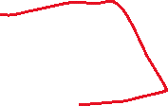






Course Learning Outcome
CLO1 | Outline the operational procedure of programming language.
CLO2 | Outline the object-oriented attribute in the programming flow.
CLO3 | Evaluate the program structure on function, branching and condition.
CLO4 | Develop a programming/syntax solution for chemical engineering case study.
CLO5 | Differentiate between solution error and syntax error for complex engineering case study

Slide 3
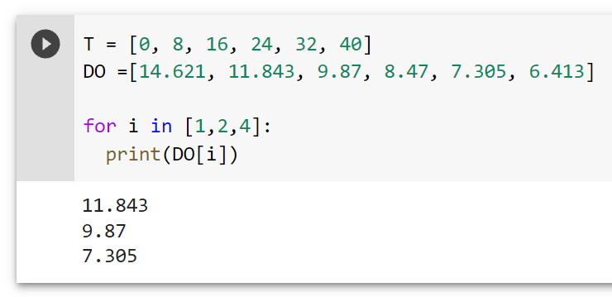



Revision 1
START
T =[0, 8, 16, 24, 32, 40]
DO =[14.621, 11.843, 9.87, 8.47, 7.305, 6.413]
The following data define the sea-level concentration of dissolved oxygen for fresh water as a function of temperature:
Develop a program to determine DO at T = 8 ºC, 16 ºC, and 32 ºC
Challenge: Compute DO at T = 26 ºC
i = 1,2,4
false
T ºC | 0 | 8 | 16 | 24 | 32 | 40
DO, mg/L | 14.621 | 11.843 | 9.870 | 8.470 | 7.305 | 6.413
i += 1
true
DO[i]
END

Slide 4



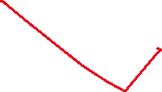

















Slide 5

Build-in Module
Refer to: https://docs.python.org/3/py-modindex.html
math — Mathematical functions
random — Generate pseudo-random numbers
types — Dynamic type creation and names for built-in types
Requirement to use MODULE
Import Module1
Import Module1 as m1

Slide 6


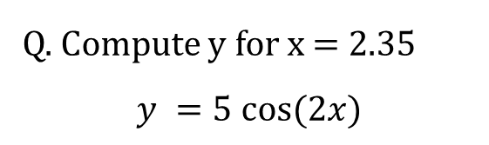

Build-in Module
Math Library
This module provides access to the mathematical functions defined by the C standard.
These functions cannot be used with complex numbers;
Available method
Mathematical functions
Power and logarithmic functions
Trigonometric functions
Constants
Etc.
Q. Compute y for x = 2.35
$$y =5 cos⁡(2x)$$
Try-It-Yourself:
import math
x = 2.35
y = 5*math.cos(x)
print('y = %0.3f'%y)

Slide 7






Exercise 1- by using MATH library
Generate random number in range of 2 to 5
Solve $y =7\sin\left(x\right)−3 \cos^{2}⁡(x)$

Slide 8
Open-source module
Visualisation
Matplotlib
Data Processing and Modeling
NumPy – Matrix manipulation
SciPy - linear algebra, optimization, and statistics
Pandas - data structures: "Series" (1D) and "Data Frames“ (2D)
Keras - neural networks and modeling
PyTorch - deep learning

Slide 9



Numpy
Fundamental package for scientific computing with Python
N-dimensional array object
Linear algebra, Fourier transform, random number capabilities
Open source
import numpy as np
A = np.array([1, 2, 3])
print(A)

Slide 10
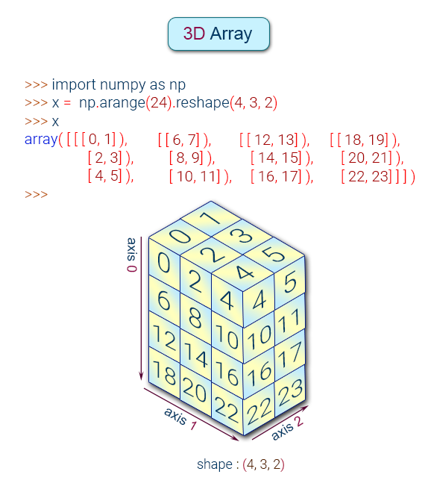
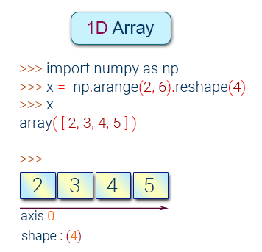
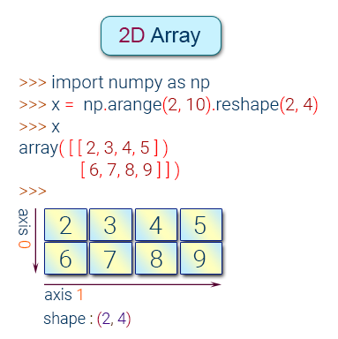


Numpy

Slide 11
Exercise 2
>> a = np.linspace(1,2,10)
>> Af = np.array([1, 2, 3], float)
>> M = np.ones((3,3))
>> k = np.random.random((4,5))
>> k[2, :]

Slide 12


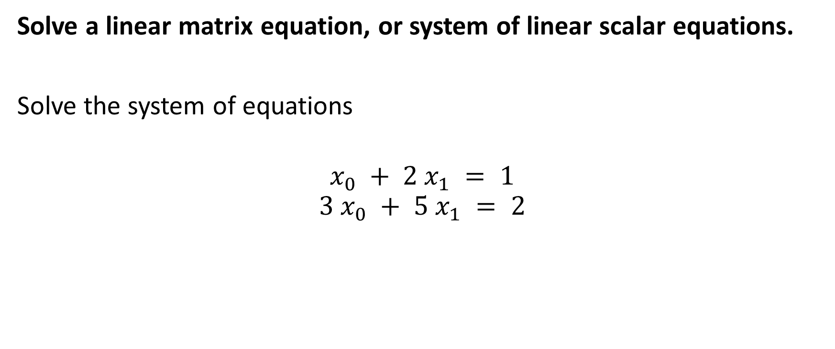
Numpy (Linear algebra)
Solve a linear matrix equation, or system of linear scalar equations.
Solve the system of equations
$$x_{0} + 2 x_{1} = 1$$
$$3 x_{0} + 5 x_{1} = 2$$
a = np.array([[1, 2], [3, 5]])
b = np.array([1, 2])
x = np.linalg.solve(a, b)

Slide 13
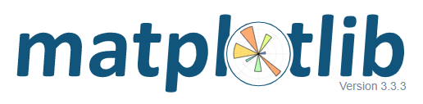
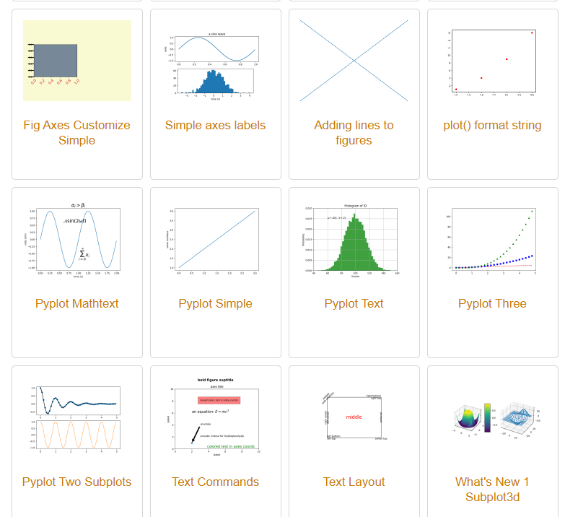
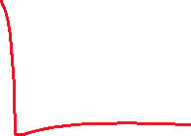
Matplotlib
Plotting library for Python
Works well with Numpy
Syntax similar to Matlab
import numpy as np
import matplotlib.pyplot as plt
x = np. linspace (0, 10, 1000)
y = np. power(x, 2)
plt.plot (x, y)
plt.show()

Slide 14
Scatter Plot
import numpy as np
import matplotlib.pyplot as plt
x = np. linspace (0, 10, 1000)
y = np. power(x, 2)
plt.plot (x, y)
plt.show()

Slide 15
Scatter Plot
Adding titles and labels
import numpy as np
import matplotlib.pyplot as plt
x = np. linspace (0, 10, 1000)
y = np. power(x, 2)
plt.plot (x, y)
plt.set_xlabel(’my x label’)
plt.set_ylabel(’my y label’)
plt.show()

Slide 16
Scatter Plot
Adding multiple lines and a legend
import numpy as np
import matplotlib.pyplot as plt
x = np. linspace (0, 10, 50)
y1 = np. power(x, 2)
y2 = np. power(x, 3)
plt.plot(x, y1, ’b−’ , label=’$x^2$ ’)
plt.plot(x, y2, ’go ’ , label=’$x^3$ ’)
plt.xlim((1 , 5))
plt.ylim((0 , 30))
plt.xlabel( ’my x label ’)
plt.ylabel( ’my y label ’)
plt.title(’plot title , including $\Omega$’)
plt.legend ()

Slide 17
Exercise 3
START
T =[0, 8, 16, 24, 32, 40]
DO =[14.621, 11.843, 9.87, 8.47, 7.305, 6.413]
The following data define the sea-level concentration of dissolved oxygen for fresh water as a function of temperature:
Plot CO over the temperature, 𝑇.
i = 1,2,4
false
T ºC | 0 | 8 | 16 | 24 | 32 | 40
DO, mg/L | 14.621 | 11.843 | 9.870 | 8.470 | 7.305 | 6.413
i += 1
true
DO[i]
END

Slide 18
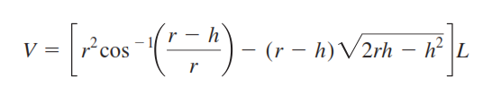
Answer on the following
Q1. By using numpy, create list of array in between 1 to 100 and display the odd number from this array.
Q2. Plot y versus x for a function of y = sin(x) from π to 2π. Display and test the program whether point at coordinate (x = 3, y = 0.5) is on the graph.
Q3. The volume V of liquid in a hollow horizontal cylinder of radius r and length L is related to the depth of the liquid h by
Develop a program to input user’s specify depth and create a plot of volume versus depth. Test the program for r = 2 m and L = 5 m.

Slide 19
End

